Slide 1
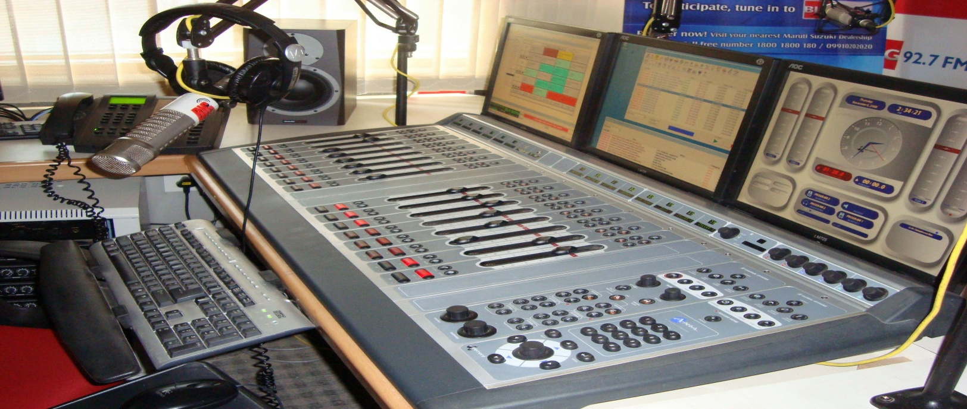
FM Radio in Pakistan

Slide 2
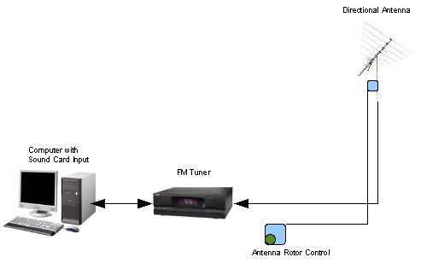
What is FM
FM stands for frequency modulation.
FM is system of broadcasting by means of frequency modulation.
In FM the sound wave or audio signals are sent on-air by the variation-modulation of their frequency.

Slide 3
Invention of FM
Edwin Howard Armstrong an American electrical engineer invented FM radio on December 26, 1933.
In Pakistan FM was introduce in 1990’s.
Frequency of FM radio stations ranges from 88 to 108 megahertz.

Slide 4
History of FM Channels.
FM Gold.
FM 100.
EMRA
FM 101.
PEMRA.
Other FM Channels.
Factors of emergence of FM channels

Slide 5
FM GOLD
PBC started FM as FM Gold in 1994. They used their own studio and staff for it.
They started it on experimental bases in three major cities of Pakistan Karachi, Lahore and Islamabad.
Duration of its transmission was 6 hours daily.
Notes:
From 7 a.m to 1p.m

Slide 6
FM 100
FM 100 was established in 1994 and started its regular transmission from 23 March 1995.
1st private radio channel.
FM 100 changed the typical trend of radio broadcasting.
More entertainment was there.
24/7 transmission.
Notes:
Mr. javad Pasha friend of current president Asif ali zardari

Slide 7
EMRA
In 1995 Javed Jabbar challenged government that they misused their executive power.
Malik Miraj the interm PM announced officially EMRA ordinance on 14 February 1997.
Airwaves are public property.
Private sector can establish radio or TV stations
Notes:
Without the participation of general public liscene was given to government favourite party.
In 1997 when nawaz shrif came in government they didn’t allowed that ordinance work.
http://javedjabbar.com/about.html

Slide 8
FM 101
FM 101 started its regular transmission from 1 October 1998.
It was based on FM 100 style.
Educational programme
More live calls
Young talent shows
Religious programmes
Old songs
Notes:
http://www.radio.gov.pk/fm101.htm

Slide 9
PEMRA and other channels
PEMRA was established on 1 March 2002.
PEMRA was established to provide licenses to private radio and TV channels keep an eye on private media working at international, national and regional level.
As the media got freedom private sector started establishing new FM channels.
FM 99 was first channel aired its transmissions after getting license.
Notes:
http://www.pemra.gov.pk/pemra/images/docs/fm/List_Of_Commercial_FM_Radio.pdf

Slide 10
Few FM channels in Lahore.
FM 93
FM 88.6 (Raasta)
FM 104.6
FM 98.6(community based)
FM 103 (Mast FM 103)
FM 89 (City FM 89)

Slide 11
FM 93
Radio Pakistan started Community Channel on 1st Feb 2009.
FM-93 network is the largest FM network in the country with 23 local and regional languages.
The FM-93 Stations broadcast a variety of program consist all formats. Like, (music‚ talks‚ interviews‚ documentaries‚ features, women‚ children‚ religion etc)

Slide 12
Mast FM 103
MAST FM 103 started its first transmission in April 2004 from Karachi, Lahore and Faisalabad.
Its transmission covers almost 47 different cities and towns with listenership of 35 million
Entertainment & information.
It has won the Brand of the Year Awards 2008, 2009 and 2010.
Notes:
It is provide entertainment and information by 19 hourly news bulletins aired from 06.00 a.m. till 12 a.m.

Slide 13
FM 88.6
05 October 2010 and enabled correctly to start on 01 December PEMRA 2010.
It is a radio station in Lahore, Pakistan that broadcasts traffic information 24 hours a day on 88.6 MHz on the FM broadcast band. It is the first 24-hour traffic program in Pakistan.

Slide 14
FM 104.6
It was launched on 22nd September 2004.
It was pioneered by Mass communication department of Punjab University by sponsorship of UNESCO.
Objectives;
To provide student professional training.
Provide entertainment and information about campus.

Slide 15
City FM 89
It aired its transmission on July 2004. It is started by Dawn Media group.
It broadcast from four major cities of Pakistan including Karachi, Islamabad, Lahore, Faisalabad and your audience is more than 1 million.
Hallmarks of 89’s style is that they broadcast almost exclusively in English.
It is targeted towards “Upper Crust”.

Slide 16
FM 98.6
FM 98.6 was launched from the platform of Lahore Chamber of Commerce and Industry (LCCI) back in September 25, 2010.
Objective;
Make FM 98.6 number one radio of the provincial metropolis.
Important show:
Dada Pota Show

Slide 17
Factors behind emergence of FM
There were three basic factors:
Monotony and Cliché.
Taste of listeners.
Break the monopoly created by Radio Pakistan.

Slide 18
Monotony n cliché
Monotony means everything is same nothing is new and different.
Cliché mean overuse of one type of artistic work to that point on which that artistic work loses its value.
Cliché and monotony in radio trend brought FM.
Notes:
://
http://www.brainyquote.com/quotes/keywords/monotony.html

Slide 19
Taste of listeners
From 1980 onward Indian songs got more popularity in Pakistan.
PBC could not allow air Indian songs.
“If you don't create change, change will create you”
Notes:
Weldo Emerson

Slide 20
Break the monopoly
From independence to 1990 Radio Pakistan has monopoly.
To break that monopoly FM 100 in 1995 aired its transmissions.

Slide 21
Early problems
Two basic problems:
Lack of trained people:
Lack of trained staff on creative side.
Lack of proper institution for training.
2. Lack of resources:
Technology.
No incentives from govt.
More sponsorship for entertainment programmes
Notes:
Today there are trained people who know media terms its ethic and rules etc.
So rjs etc started their work without proper training
Only good voice was cosidered bench mark for selection of rjs.
After that training workshops and institutes started working.

Slide 22
Changes and current situation
FM channels got popularity.
Excitement of two way communication.
Frank style of RJs.
News bulletin along with entertainment.
More than 116 FM channels.
Listenership is more in urban areas.

